Slide 1
CS61B Discussion 6
Disjoint Sets and Asymptotics

Slide 2
Administrivia
Fill out the weekly surveys!
Pacing points and feedback you have for us :); check Piazza!
Midterm 1 solutions and grades are out!
CSM sections are available, http://scheduler.csmentors.org/!
Post-midterm advising appointments
Sign-up on Piazza or let me know if you want to talk in the discussion survey today.
Optional online textbook!
You can find readings that correspond to the lecture videos under the ‘Readings’ column of the website
Discussion survey (please fill this out!): tinyurl.com/cz-disc6-sp19

Slide 3
Motivation: Measuring Runtime
How do we measure the runtime of a program?
How do we compare the runtime of two programs as the input size grows?
Notes:
The first question is fairly straightforward, but the goal is to get students thinking about flaws in more conventional ways of measuring how fast a program runs, like timing or counting the number of operations. The discussion will probably lead you to students saying you can come up with an algebraic expression for the number of operations based on the inputs.
The second question hopefully will guide students to about what exactly we need to measure when comparing the runtime of two programs. Different from measuring something with a tangible quantity like time, we need to be able to generalize to all different kinds of input and think about worst case inputs as well. Hopefully this gets students to think of inputs where the size approaches infinity - a good segue into big o notation.

Slide 4
Measuring Order of Growth
Determine a cost model (in this case number of operations)
Define an algebraic expression f(n) that expresses this cost for some input n.
Drop multiplicative constants and lower order terms
Any exponential dominates any polynomial
Any polynomial dominates any logarithm
Notes:
Based on the previous discussion, students should come up with some way to ‘count’ operations of a given process and then come up with an algebraic expression for the operations.

Slide 5
Θ (Big Theta)
Let f(n) and g(n) be positive real numbers on inputs of size n
f ∈ Θ(g) if there is a constant c1 > 0 and c2 > 0 s.t.
c1 g(n) <= f(n) <= c2 g(n) for all c1 <= c2
Tightly bounded by g(n) when n gets significantly large.
Notes:
The important point here is big theta is just squeezing the runtime between big O and big Omega. It’s a tight bound so best and worst case. Always case.

Slide 6
Big O
Let f(n) and g(n) be positive real numbers on inputs of size n
f ∈ O(g) if there is a constant c > 0 s.t.:
f(n) <= c g(n)
Upper bounded by g(n) when n gets significantly large.
Bound does not have to be tight.
Big Theta is to “equals” as Big O is to “less than or equal”

Slide 7
Theta, Big O simplified
Informally:
f(x) ∈ Θ( g(x) ) → f(x) == g(x)
f(x) ∈ O( g(x) ) → f(x) <= g(x)
*for very large x (x being input size)

Slide 8
Common Asymptotic Sets
Θ (1): constant
Θ (log n): logarithmic
Θ (sqrt(n)): square root
Θ (n): linear
Θ (n log n): n log n
Θ (n^2): quadratic
Θ (n^3): cubic
Θ (2^n): exponential
Θ (n!): factorial
Notes:
Good recap after the first problem.

Slide 9
Disjoint Sets
Also sometimes called “Union Find”
keeps track of whether or not elements are connected
empires that are constantly conquering one another
each empire is identified by a ruling element.
Three basic functions:
connect(a, b)
brings b into a’s empire (a conquers b)
isConnected(a, b)
returns whether or not a and b are in the same empire.
find(a)
Returns the “ruler” of empire a.
Also sometimes called union(a, b)

Slide 10
Implementations of Disjoint Sets
Disjoint sets can be implemented in multiple ways, each with its own benefits and drawbacks.
Quick Find → quick to find if two are connected
Quick Union → quick to connect
Weighted Quick Union → quick union, but with some optimization

Slide 11
Quick Find
Use an array to store which set each element is in.
Called quick find because it is very fast to find if two elements are in the same set (isConnected(a,b)), since you just need to check if id[a] = id[b].
{ 0, 1, 2, 4 }, {3, 5}, {6}
0
1
2
3
6
0 1 2 3 4 5 6
4
5
int[] id
0 | 0 | 0 | 3 | 0 | 3 | 6
Analogy: Each set is an “empire” and is identified by its ruler. 0, 3, 6 are the individual rulers and all the other elements belong to their empires.
Notes:
Talk about how connect and isConnected work
Connect:
When you connect two elements, you are actually connecting their respective sets. If they are single-element sets then this is easy, because you just directly connect the two elements (which requires making one element’s “ruler” the other element)
But, if they are not single-element sets, then you need to first find the ruler of both sets, Then, you need to connect all of the elements in one set to the other set.
isConnected:
Is Connected is easy, you just check if the elements have the same “ruler”

Slide 12
Quick Union
Use an array to store the parent of each node
-1 indicates that an item is a root.
int[] parent
-1 | 0 | 1 | -1 | 0 | 3 | -1
0 1 2 3 4 5 6
0
1
3
6
4
2
5
Notes:
Talk about how connect and isConnected work
Connect:
When you connect two elements, you just need to make one element’s parent the other element.
isConnected:
To find if two elements are connected, you need to traverse up to the root of each tree and see if the roots are the same.

Slide 13
Weighted Quick Union
Quick Union, but always add smaller tree to larger tree
connect(3,8)
This way, the tree won’t become extremely tall
Each index holds the index of its parent element except the root which holds the negative size of the set (the optional Algorithms textbook implements Disjoint Sets in a different way).
-6 | 0 | 0 | 0 | 0 | 0 | -4 | 6 | 6 | 8
-10 | 0 | 0 | 0 | 0 | 0 | 0 | 6 | 6 | 8
0 1 2 3 4 5 6 7 8 9
0 1 2 3 4 5 6 7 8 9
0
0
6
1
2
3
4
5
6
1
2
3
4
5
7
8
7
8
9
9
Notes:
Talk about how connect and isConnected work
Connect:
When you connect two elements, first call “find” on both, then make
isConnected:
To find if two elements are connected, you need to traverse up to the root of each tree and see if the roots are the same. (find)

Slide 14
Weighted Quick Union with Path Compression
When you call find (recall that union calls find as well), as you traverse to the root, reassign every node’s parent to the root. (Each node on path to the root should be reassigned)
find(10)
6
6
7
8
7
8
9
10
9
10

Slide 15
Disjoint Set Runtimes
Implementation | Constructor | connect | isConnected
QuickFindDS | Θ(N) | Θ(N) | Θ(1)
QuickUnionDS | Θ(N) | O(N) | O(N)
WeightedQuickUnionDS | Θ(N) | O(log N) | O(log N)
^ with Path compression | Θ(N) | Slightly more than constant* | Slightly more than constant*
*Technically inverse ackermann function (in lecture), but pretty much constant
*: See lecture for the full story.

Slide 16
Problem 1.1
What are two improvements that we made to our naive implementation of the UnionFind ADT during lecture 14 (Monday’s lecture)?

Slide 17
Problem 1.1 Solutions
What are two improvements that we made to our naive implementation of the UnionFind ADT during lecture 14 (Monday’s lecture)?
The naive implementation was maintaining a List<Set<Integer>>. Improvements made were:
Keeping track of sets rather than connections (QuickFind)
Tracking set membership by recording parent not set # (QuickUnion)
Union by Size (WeightedQuickUnion)
Path Compression (WeightedQuickUnionWithPathCompression)

Slide 18
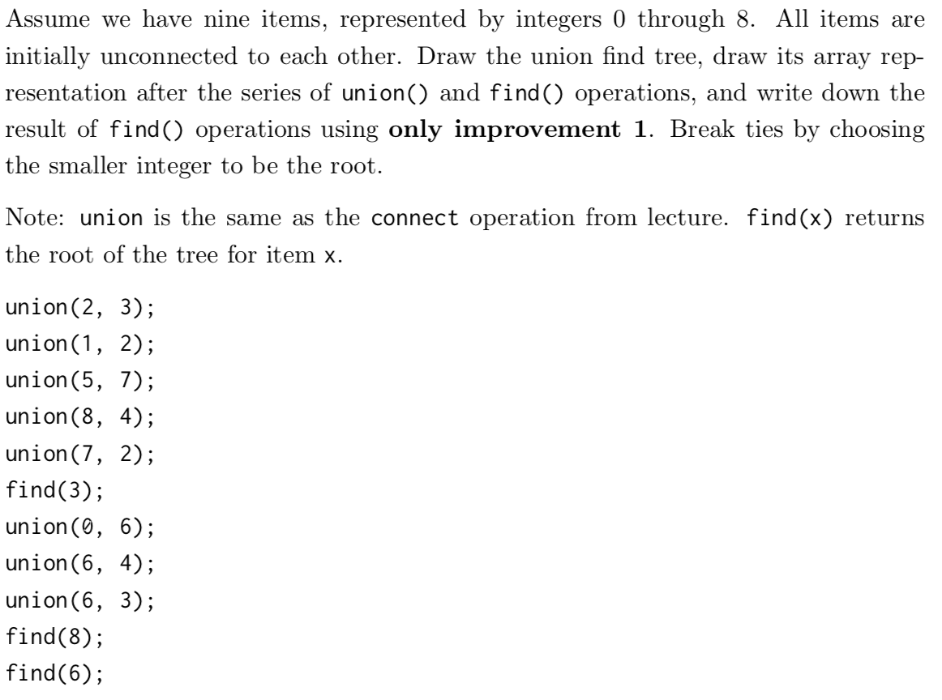
Problem 1.2

Slide 19
0
1
2
3
4
5
6
7
8
DisjointSets have a fixed number of items - in this case items 0 through 8.
To start, each item is in its own subset.

Slide 20
0
1
2
3
4
5
6
7
8
union(2, 3)

Slide 21
0
1
2
4
5
6
7
8
3
union(2, 3)

Slide 22
0
1
2
4
5
6
7
8
3
union(1, 2)

Slide 23
0
2
4
5
6
7
8
1
3
union(1, 2)

Slide 24
0
2
4
5
6
7
8
1
3
union(5, 7)

Slide 25
0
2
4
5
6
8
1
3
7
union(5, 7)

Slide 26
0
2
4
5
6
8
1
3
7
union(8, 4)

Slide 27
0
2
4
5
6
1
3
8
7
union(8, 4)

Slide 28
0
2
4
5
6
1
3
8
7
union(7, 2)

Slide 29
0
2
4
6
1
3
5
8
7
union(7, 2)

Slide 30
0
2
4
6
1
3
5
8
7
find(3)

Slide 31
0
2
4
6
1
3
5
8
7
find(3)

Slide 32
0
2
4
6
1
3
5
8
7
find(3)
=> 2

Slide 33
0
2
4
6
1
3
5
8
7
union(0, 6)

Slide 34
0
2
4
6
1
3
5
8
7
union(0, 6)

Slide 35
0
2
4
6
1
3
5
8
7
union(6, 4)

Slide 36
0
2
6
4
1
3
5
8
7
union(6, 4)

Slide 37
0
2
6
4
1
3
5
8
7
union(6, 3)

Slide 38
2
0
1
3
5
6
4
7
8
union(6, 3)

Slide 39
2
0
1
3
5
6
4
7
find(8)
find(6)
=> 2
=> 2
8

Slide 40
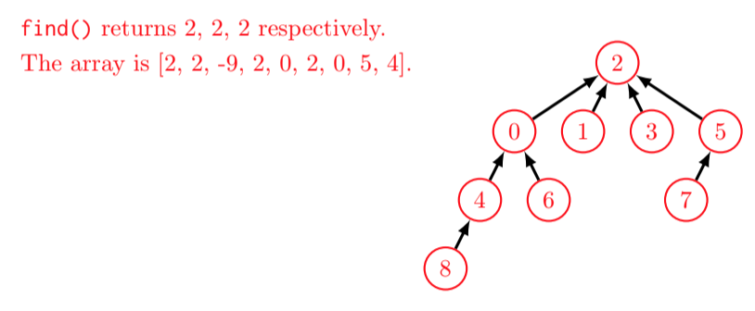
Problem 1.2 Solutions
Note: find(2) would return 2, not -9!
Notes:
Walk them through each union/find call

Slide 42
0
1
2
3
4
5
6
7
8
DisjointSets have a fixed number of items - in this case items 0 through 8.
To start, each item is in its own subset.

Slide 43
0
1
2
3
4
5
6
7
8
union(2, 3)

Slide 44
0
1
2
4
5
6
7
8
3
union(2, 3)

Slide 45
0
1
2
4
5
6
7
8
3
union(1, 2)

Slide 46
0
2
4
5
6
7
8
1
3
union(1, 2)

Slide 47
0
2
4
5
6
7
8
1
3
union(5, 7)

Slide 48
0
2
4
5
6
8
1
3
7
union(5, 7)

Slide 49
0
2
4
5
6
8
1
3
7
union(8, 4)

Slide 50
0
2
4
5
6
1
3
8
7
union(8, 4)

Slide 51
0
2
4
5
6
1
3
8
7
union(7, 2)

Slide 52
0
2
4
6
1
3
5
8
7
union(7, 2)

Slide 53
0
2
4
6
1
3
5
8
7
find(3)

Slide 54
0
2
4
6
1
3
5
8
7
find(3)

Slide 55
0
2
4
6
1
3
5
8
7
find(3)
=> 2

Slide 56
0
2
4
6
1
3
5
8
7
union(0, 6)

Slide 57
0
2
4
6
1
3
5
8
7
union(0, 6)

Slide 58
0
2
4
6
1
3
5
8
7
union(6, 4)

Slide 59
0
2
6
4
1
3
5
8
7
union(6, 4)

Slide 60
0
2
6
4
1
3
5
8
7
union(6, 3)

Slide 61
2
0
1
3
5
6
4
7
8
union(6, 3)

Slide 62
2
0
1
3
5
6
4
7
8
find(8)

Slide 63
2
0
1
3
5
6
4
7
8
find(8)

Slide 64
2
0
1
3
5
6
4
7
8
find(8)

Slide 65
2
0
1
3
5
6
4
7
8
find(8)

Slide 66
2
0
1
3
5
6
4
7
8
find(8)

Slide 67
2
1
3
5
0
6
4
7
8
find(8) => 2

Slide 68
2
1
3
5
0
6
4
7
8
find(6)

Slide 69
2
1
3
5
0
6
4
7
8
find(6)

Slide 70
2
1
3
5
0
6
4
7
8
find(6)

Slide 71
2
1
3
5
0
6
4
7
8
find(6)

Slide 72
2
1
3
5
0
6
4
7
8
find(6)

Slide 73
2
5
0
6
4
3
1
8
7
Calling connect or isConnected now is super fast!

Slide 74
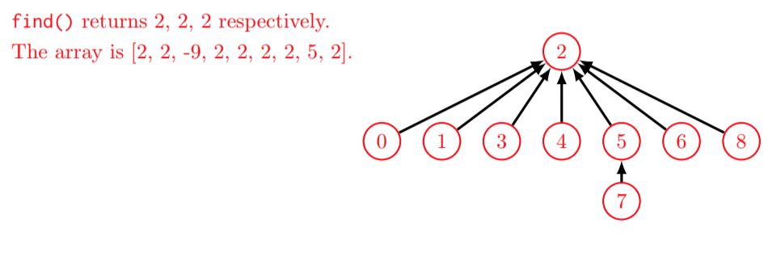
Problem 1.3
Note: find(2) would return 2, not -9!

Slide 75

Asymptotics: Big Ө(...)
Called “big theta notation”
k1 * f(N) <= R(N) <= k2 * f(N)
R(N) = runtime, f(N) = function, k’s = constants
The runtime can be both upper and lower bounded by the function
Let’s say R(N) = 3n³ + 2n² + 1
What is a good f(N), k₁, k₂?
f(N) = n³, k₁ = 2, k₂ = 4

Slide 76


Asymptotics: Big O(...)
Called “big oh notation”
R(N) = runtime, f(N) = function, k = constant
The function is an upper bound on the runtime
DOES NOT MEAN WORST CASE
True or false?
N² ∈ O(N²)
N² ∈ O(N⁵⁰⁰)
N log N ∈ O(N)
log N ∈ O(N²)

Slide 77
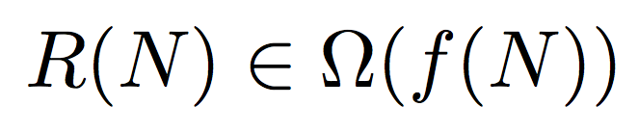
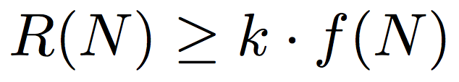
Asymptotics: Big Ω(...)
Called “big omega notation”
R(N) = runtime, f(N) = function, k = constant
The function is a lower bound on the runtime
DOES NOT MEAN BEST CASE
True or false?
N² ∈ Ω(N²)
N ∈ Ω(1)
N² ∈ Ω(N³)

Slide 78
Example with the bounds
public void printElementsWithACatch(int[] arr) {
Random r = new Random; int val = r.randInt(100);
if (val < 10) {
System.out.println(“The array is empty”);
return;
}
for (int i = 0; i < arr.length; i++) {
System.out.println(arr[i]);
}
}
Let’s define N as arr.length.
What is the runtime of this function?
What is the worst case runtime of this function?
What is the best case runtime of this function?
Ω(1), O(N)
Θ(N)
Θ(1)

Slide 79
Problem 2.1
Order the big Theta runtimes

Slide 80
Problem 2.1 Solutions
Θ (1) ⇢ Θ (logn) ⇢ Θ (n) ⇢ Θ (nlogn) ⇢ Θ (n² logn) ⇢ Θ (n³) ⇢ Θ (2^{n}) ⇢ Θ (n!) ⇢ Θ (n^{n})

Slide 81
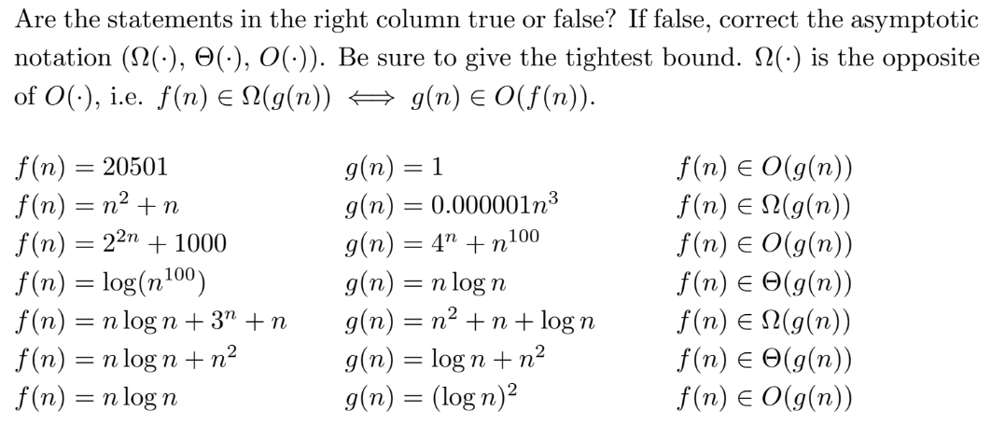
Problem 2.2
Informally:
f(x) ∈ Θ( g(x) ) → f(x) == g(x)
f(x) ∈ O( g(x) ) → f(x) <= g(x)
f(x) ∈ Ω( g(x) ) → f(x) >= g(x)
*for very large x (x being input size)

Slide 82
Problem 2.2 Solutions
True, although Θ(·) is a better bound.
False, O(·). Even though n^3 is strictly worse than n^2, n^2 is still in O(n^3) because n^2 is always as good as or better than n^3 and can never be worse.
True, although Θ(·) is a better bound.
False, O(·).
True.
True.
False, Ω(·).

Slide 83
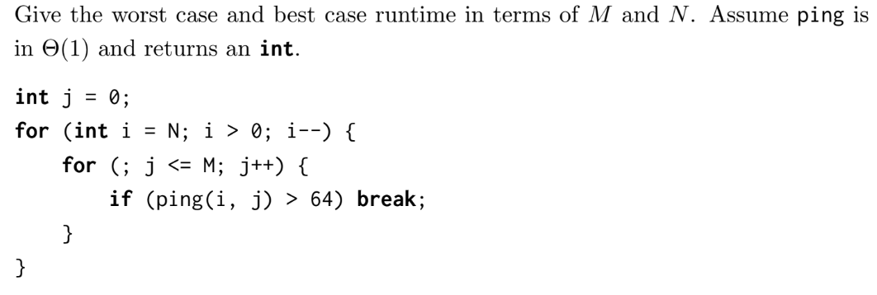
Problem 2.3

Slide 84
Problem 2.3 Solutions
Worst: Θ(M + N), Best: Θ(N) The trick is that j is initialized outside the loops!

Slide 85
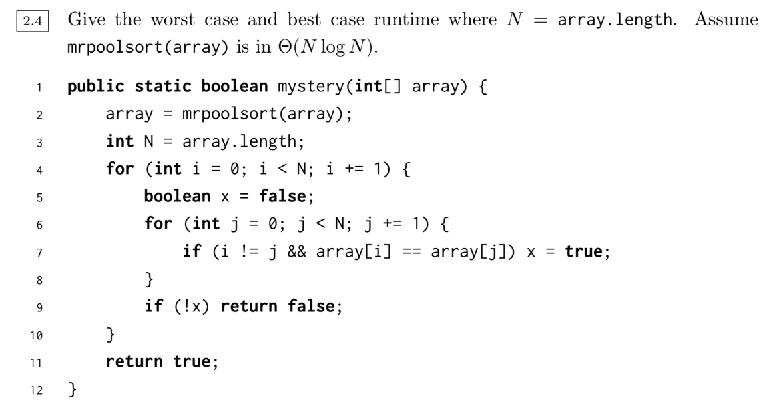
Problem 2.4

Slide 86
Problem 2.4 Solutions
Worst: Θ(N^2), Best: Θ(N log N) Remember sorting in the beginning!

Slide 87
What is Mystery doing?

Slide 88
What is Mystery doing?
mystery() returns true if every int has a duplicate in the array (ex. {1, 2, 1, 2}) and false if there is any unique int in the array (ex. {1, 2, 2}).

Slide 89
Using an ADT, describe how to implement mystery() with a better runtime.
Then, if we make the assumption an int can appear in the array at most twice, develop a solution using only constant memory.
A Θ(N) algorithm is to use a map and do key = element and value = number of appearances, then make sure all values are > 1. Uses O(N) memory however. Can do constant space by sorting then going through, but sorting is generally in O(n log n) time.

